Slide 1
Pelvic floor dysfunction
Julia H Herbert
MCSP. MSc. MPOGP
Consultant Physiotherapist

Slide 2
Myth busters!
Only women experience pelvic floor dysfunction (PFD)
PFD causes symptoms because the pelvic floor muscles are weak
PFD only causes bladder leakage

Slide 3
Common symptoms of PFD
Lower Urinary Tract Dysfunction (LUTS)
includes symptoms of urinary incontinence, urgency, urinary frequency, nocturia, voiding difficulty / a feeling of incomplete bladder emptying
Lower Bowel Dysfunction (LBD)
includes symptoms of fecal incontinence, constipation / incomplete emptying, obstructed defecation
Sexual dysfunction
includes symptoms of erectile and ejaculatory dysfunction, dyspareunia, orgasmic dysfunction
Chronic pelvic pain

Slide 4
Urinary incontinence and the pelvic floor?
The two most common types of UI are:
Stress urinary incontinence (SUI)
The hammock of the pelvic floor needs to provide resistance to the downward and backwards movement of the bladder and urethra to provide compression of the urethra during times of increased intra-abdominal pressure – coughing, sneezing, running, laughing, gym class
Urgency Urinary Incontinence (UUI)
Perineo-detrusor inhibitory reflex - a contraction of the PFM inhibits a detrusor contraction via a sacral reflex inhibition → voluntary suppression of micturition
Mahony et al, 1977

Slide 5
Constipation
Obstructed defaecation:
difficulty in evacuation due to a mechanical obstruction
may be due to a pelvic floor muscle dysfunction and can affect both men and women
D’Ancona et al 2019 (ICS Standardisation)

Slide 6
Constipation
Deep pelvic floor muscle - Puborectalis
(paradoxical contraction / non-relaxing puborectalis) does not allow the anorectal angle to straighten and blocks stool leaving the rectum
D’Ancona et al 2019 (ICS Standardisation)

Slide 7
Constipation
External Anal Sphincter (EAS)
(paradoxical contraction – anismus / non-relaxing EAS) narrows the anal canal – stool may be unable to be passed or if soft enough comes out as a string or ‘worm’
D’Ancona et al 2019 (ICS Standardisation)

Slide 8
Faecal / anal incontinence
Loss of flatus
Loss of solid / liquid stool
Faecal (rectal) urgency
Faecal urgency incontinence
Passive incontinence: Liquid or solid stool loss with no awareness
Overflow incontinence - due to an overfull rectum or faecal impaction
Stress faecal incontinence – leakage with cough / sneeze / physical exertion
Coital incontinence - leakage
D’Ancona et al 2019 (ICS Standardisation)

Slide 9
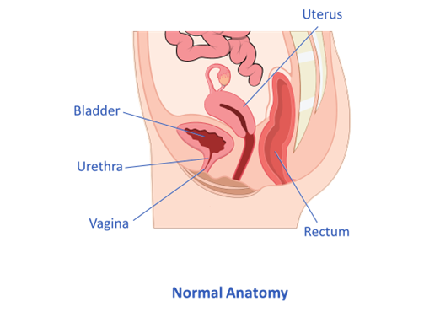
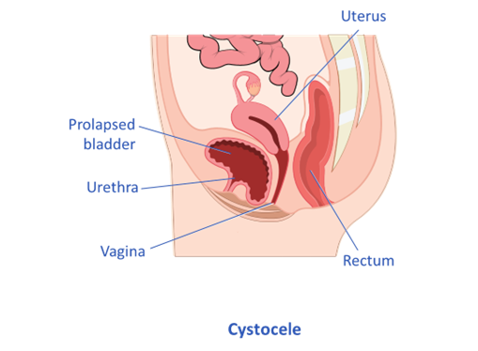
Pelvic organ prolapse
Prolapse means "to fall out of place", from the Latin prolabi meaning "to fall out".
1) Anterior vaginal wall prolapse
Cystocele – Bladder
Cyst urethrocele – Bladder and Urethra
1)

Slide 10
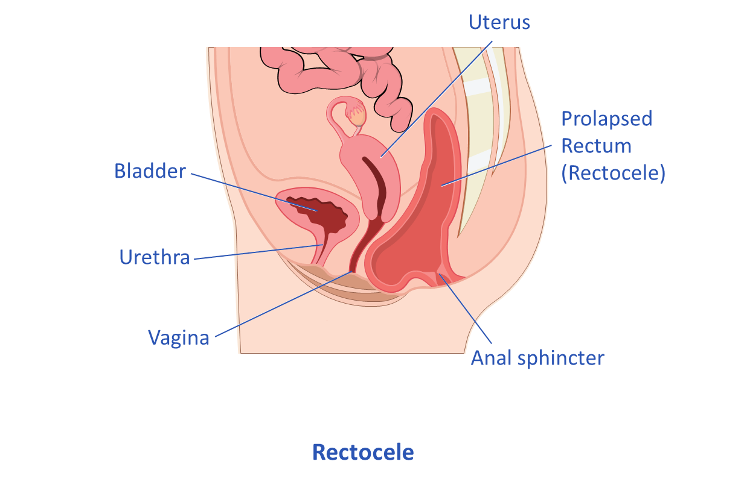
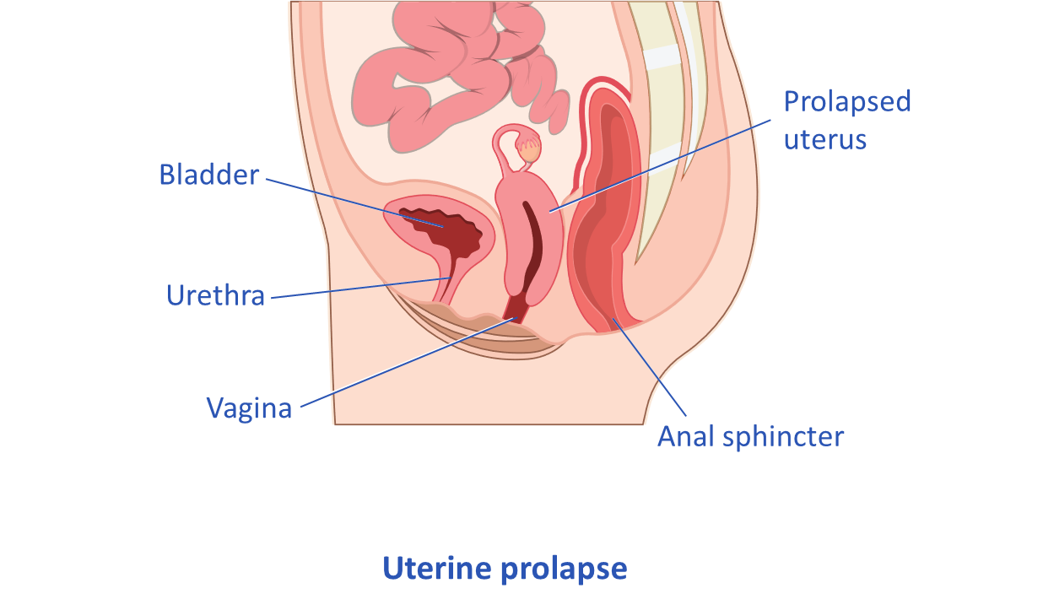
Pelvic organ prolapse
2) Posterior vaginal wall prolapse
Rectocele – Bowel
3) Uterine
Procidentia
May also have:
Apical
Enterocele – small intestine /
vaginal vault prolapse
2)
3)

Slide 11
Common causes of PFD
Pregnancy & Childbirth
Particular risk factors are large babies (>4kg), instrumental delivery (forceps / ventous), long 2nd stage labour, breech presentation. Obstetric anal Sphincter Injury (OASI)
Hormonal changes
Often damage that occurs at the time of delivery becomes evident at the menopause, some women experience worsening of incontinence at certain times in the menstrual cycle
Urinary Tract Infection (UTI)
The irritation of the bladder and pain on passing urine can cause the pelvic floor muscles to become overactive

Slide 12
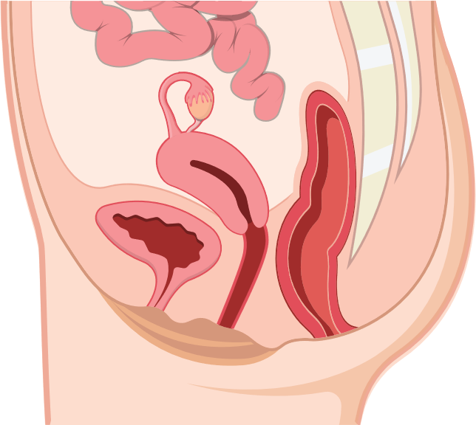
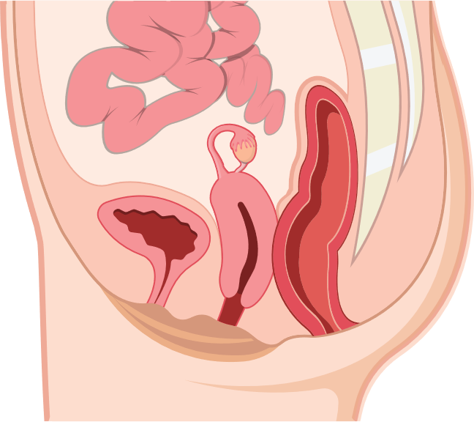
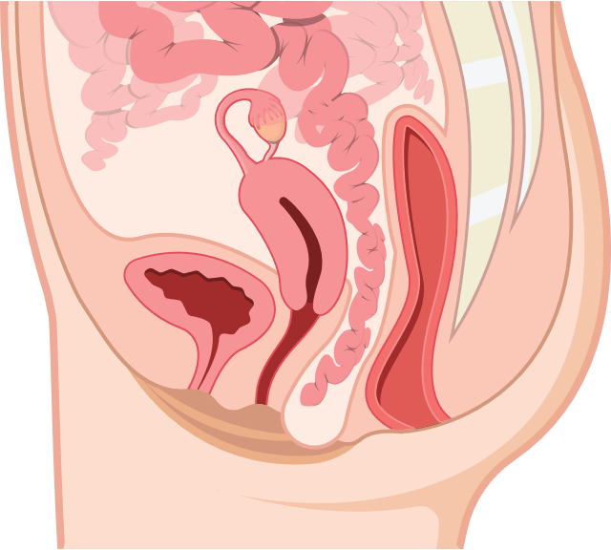
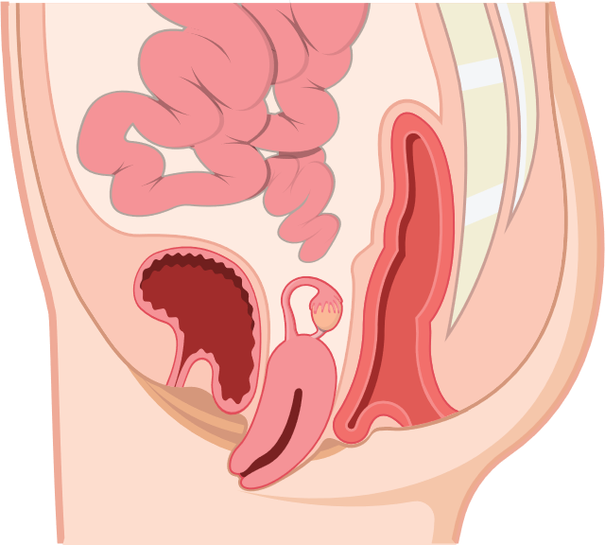
Uterine - Procidentia
Normal Anatomy
Uterine prolapse
Procidentia
Apical
Enterocele
Small intestine
Enterocele
Vaginal vault prolapse
Notes:
Uterine
Procidentia
May also have:
Apical
Enterocele – small intestine / vaginal vault prolapse

Slide 13
Common causes of PFD
Surgery
Hysterectomy (removal of the uterus in women) or gall bladder surgery (cholecystectomy)
Prostate surgery
Anal surgery may damage the anal sphincters
Chronic straining at stool - constipation
Smoking
Chronic cough – Long Covid?
Heavy Lifting / Excessively High impact exercises?
Ageing

Slide 14
Conservative therapy for PFD
Pelvic Floor Muscle Exercises
Biofeedback
Neuromuscular electrical stimulation
Myofascial stretching
Breathing exercises
Defaecation Dynamics
Vaginal pessaries / insert devices

Slide 15
Clean Intermittent Self Catheterisation (CISC)
In cases where the pelvic floor dysfunction is causing:
an inability to empty or completely empty the bladder – risk of UTI
hesitancy or intermittent stream
- the introduction of the patient being able to pass a urinary catheter (CISC) themselves can give them more control over their symptoms.
Advantages:
Reduces the risk of urine infection
Reduces the risk of damage to other structures, bladder, kidneys, ureters from increased pressure in the bladder due to urinary retention
Reduced healthcare professional involvement
May allow spontaneous recovery of bladder function

Slide 16
Case study: JENNY
Jenny had a very difficult delivery with Mable her 2nd baby. Mable was very big (4.5kg)!
During her labour Jenny decided to have an epidural for pain relief. Jenny was pushing for a long time (3 hours) and baby was eventually delivered by forceps with an episiotomy.
Post nattily Jenny found it impossible to pass urine and when she was checked she had over 2 litres of urine in her bladder.
She was given an indwelling catheter for 24 hours but when this was removed, she was still unable to pass urine.
Keen to get home to her other daughter Annie (aged 4) she agreed to try CISC.
This was very helpful to Jenny and over the next few weeks she followed a timed voiding programme, learning to relax her pelvic floor muscles when voiding.
She was able to maintain her bladder health by using CISC to check she was empty.
Fortunately for Jenny, her bladder function slowly recovered, and she was able to stop using the CISC when Mable was 4 months old.

Slide 17
Transanal Irrigation (TAI)
Transanal irrigation (sometimes called anal or rectal irrigation) is used for both chronic constipation and faecal incontinence when other methods of management have failed. It involves instilling warm water into the rectum and lower (sigmoid) colon via the anus to empty out the stool.
The amount of water used to irrigate can vary from 100mls to 1000mls. The amount of water will determine whether the irrigation is categorised as mini or full.

Slide 18
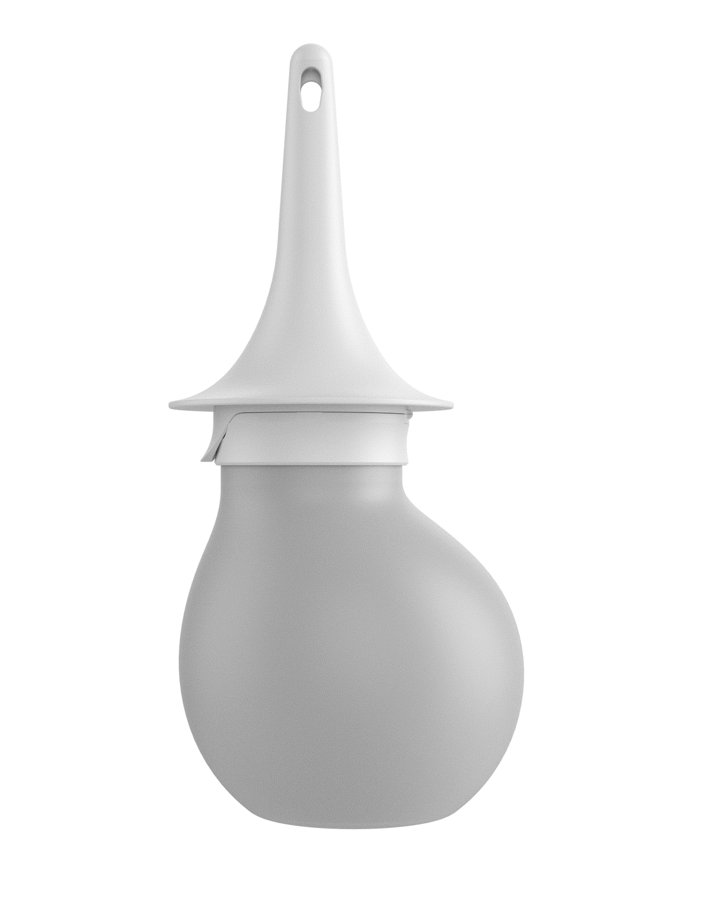
Transanal Irrigation (TAI)
Transanal irrigation is very safe so long as the instructions are followed.
There is a very small risk of a perforation (hole) developing in the bowel in patients who use this treatment. This risk is minimal if the instructions are followed
Other minor complications include a small amount of bleeding, pain, nausea, and fatigue.
The Pelvic Floor Society 2019
NICE (MTG 136) 2022

Slide 19
Use of mini or full TAI
The ability to empty the rectum can be useful for both constipation and anorectal incontinence of solid or liquid stool.
Obstructed defaecation:
Using warm water to soften the stool and stimulate rectal emptying, protects the rectal mucosa from the potential irritation and or damage from the use of rectal medications and is much more effective for obstructed defaecation than taking an oral laxative which is often what GP’s prescribe
Anal incontinence:
Having the confidence that the rectum is empty can allow patients at risk of an accidental bowel leakage to return to normal everyday activities reducing anxiety, isolation, depression and restoring social relationships

Slide 20
Case study: NORMA
Norma (aged 72) has one passion in life – ballroom dancing, she started age 4!
Sadly, over the last few years she has become more and more nervous about going dancing with her husband because her bowels are so unpredictable.
She recently had an episode of accidental bowel leakage on the dancefloor and was so embarrassed she vowed never to go ballroom dancing again.
This made her feel miserable and was starting to affect her relationship with her husband.
She responded well to learning how to exercise her anal sphincter muscles but, the lifechanging difference came when she was introduced to low volume transanal irrigation (TAI).
She now has the confidence to go on the dancefloor again, she just uses her irrigation kit that morning and is confident that nothing is going to leak out. She has even just won a medal at an over 70’s afternoon tea-dance!
Norma will continue to use TAI for as long as she keeps dancing.

Slide 21
Thank you
Julia H Herbert
MCSP. MSc. MPOGP
Consultant Physiotherapist

Slide 23
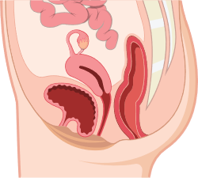
Anterior vaginal wall prolapse
Uterus
Uterus
Bladder
Prolapsed
bladder
Urethra
Urethra
Vagina
Rectum
Vagina
Rectum
Normal Anatomy
Cystocele – Bladder
Cystourethrocele – Bladder and Urethra
Notes:
Prolapse means "to fall out of place", from the Latin prolabi meaning "to fall out".
Anterior vaginal wall prolapse
Cystocele – Bladder
Cystourethrocele – Bladder and Urethra

Slide 24
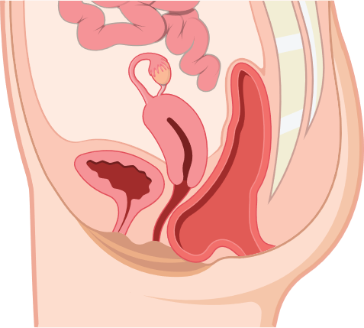
Posterior vaginal wall prolapse
Uterus
Uterus
Prolapsed
Rectum
(Rectocele)
Bladder
Bladder
Urethra
Urethra
Vagina
Vagina
Rectum
Anal sphincter
Normal Anatomy
Rectocele – Bowel
Notes:
Posterior vaginal wall prolapse
Rectocele – Bowel

Slide 25
Normal vs Weak Pelvic floor

Slide 26
Normal vs Weak Pelvic floor

