Slide 2
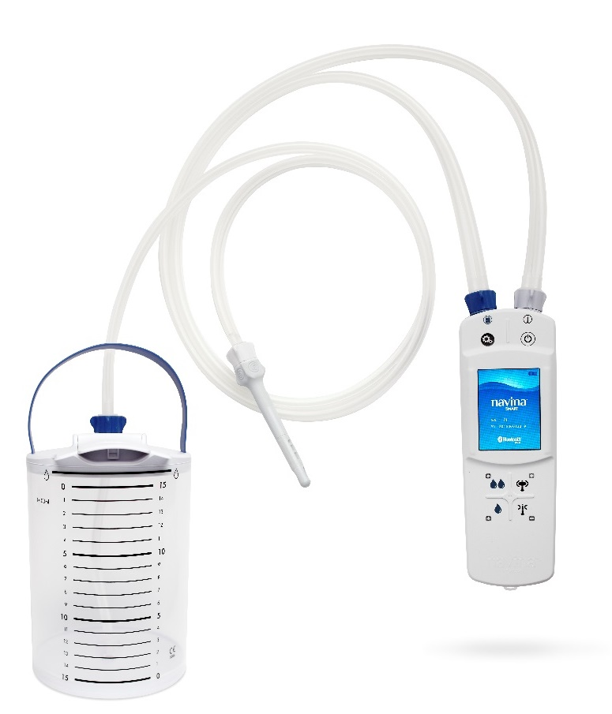
FIRST CLINICAL STUDY
- NAVINA SMART
Presented at ICS 2017 by V Passananti
Passananti et al. J Pharm Pharmacol, 6 (2018) 380-394

Slide 3

Patients using transanal irrigation (TAI)
Per Protocol Population
(n=19)
Exclusions & Deviations
(n=3)
Safety Analysis
(n=28)
Recruited
(n=31)
Hand function:
68% Normal
29% Bilateral impaired
Conditions:
68% SCI
14% MS
7% Spina bifida
11% Other
Gender & Age
17 Male
11 Female
Mean age of 51 (range 24-73)

Slide 4

Result - Compliance & Satisfaction
28
Patients analyzed
14 (74%)
Wanted to continue
with Navina
19 (68%)
Patients on Navina
Satisfaction
12 (63%)
Complete or
adequate satisfaction
Satisfaction
4 weeks
Compliance
10
14 (74%)
At baseline
Not happy with TAI
Wanted to continue
with Navina

Slide 5


General perception of Navina Smart
96% (26/27)
neutral, easy, very easy to handle (preparation)
27 Patients
replied to follow-up questionnaire
67% (18/27)
neutral, practical, very practical (usability)
67% (18/27)
neutral, satisfied, very satisfied (satisfaction)
52% (14/27)
felt the system saved time spent on the toilet

Slide 6
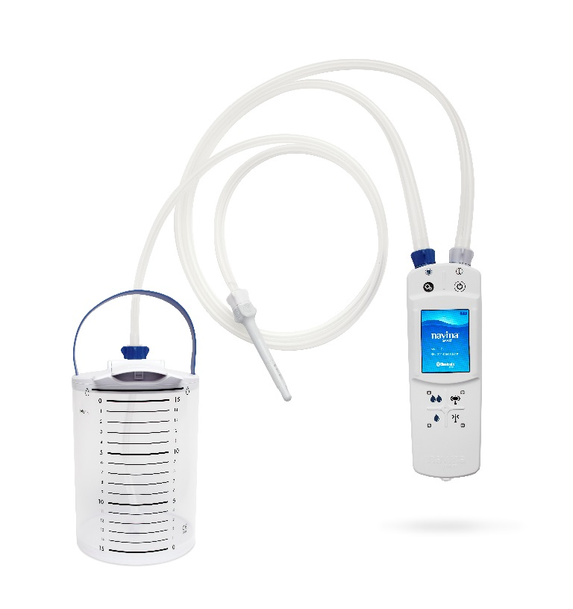
Conclusion
Navina Smart is a safe novel
transanal irrigation system
It is well tolerated and satisfactory in two-thirds of patients who were unsatisfied with existing irrigation systems
Use of the electronic unit of Navina Smart is perceived as easy by the majority
Patients who were independent with bowel care tends to perform best

Slide 7
Wellspect HealthCare, Aminogatan 1, P.O. Box 14, SE-431 21 Mölndal, Sweden. Phone: +46 31 376 40 00.

