Slide 1

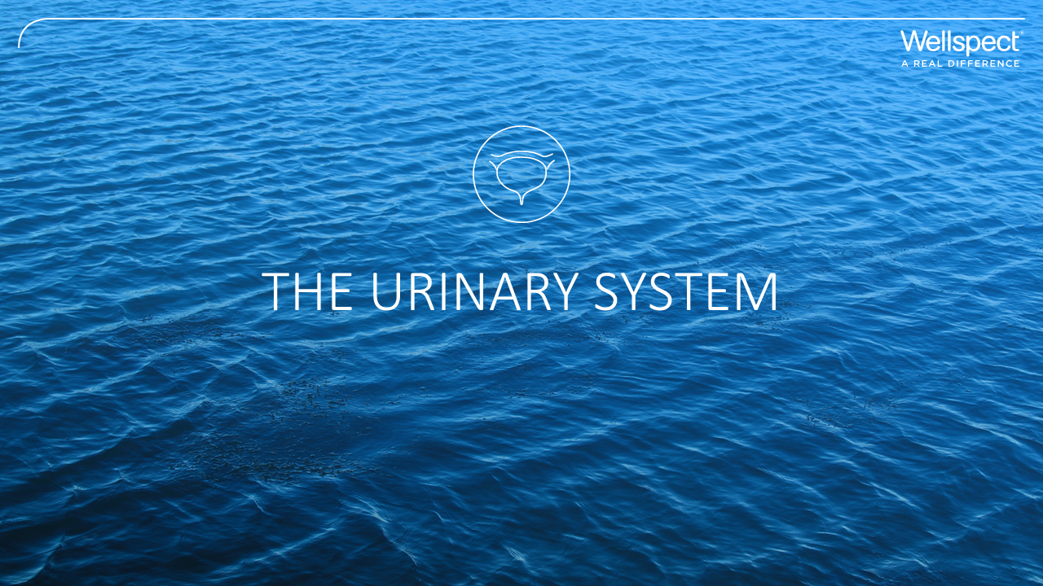

Slide 2
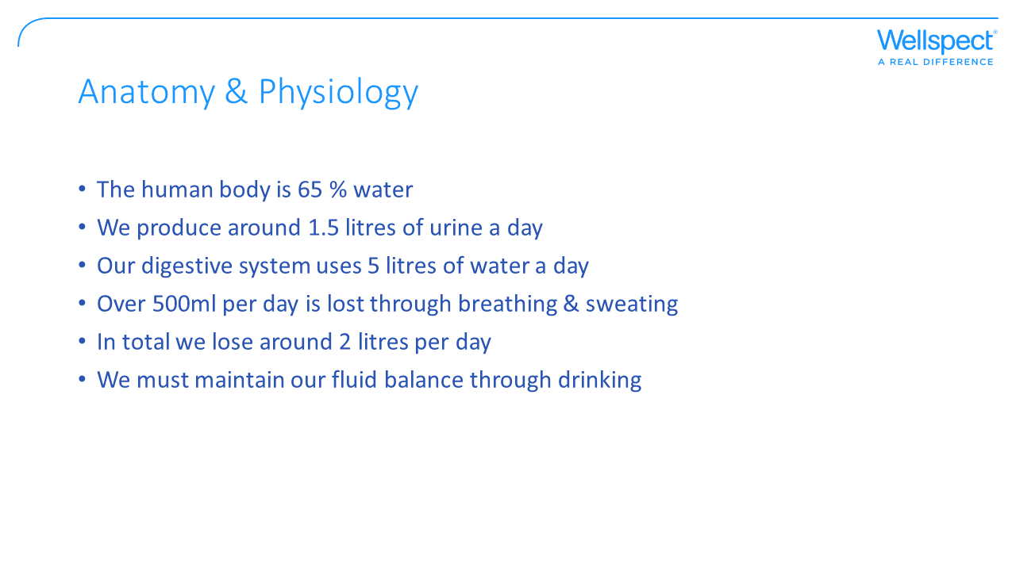

Slide 3
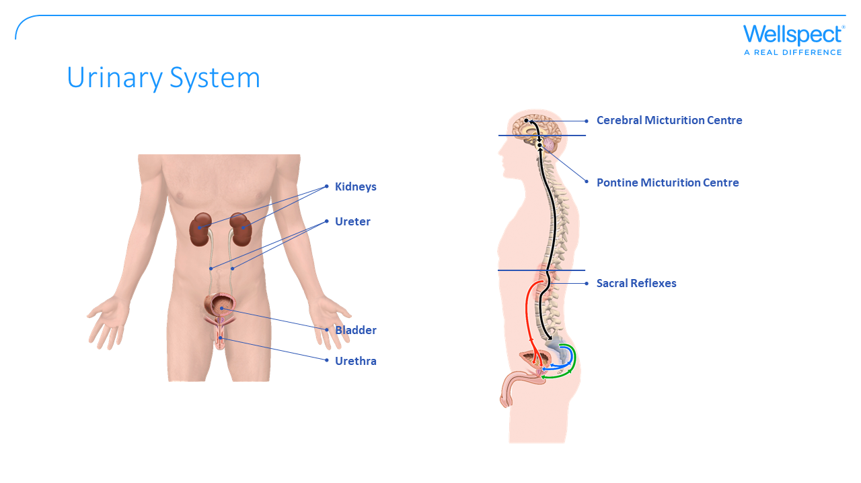

Slide 4
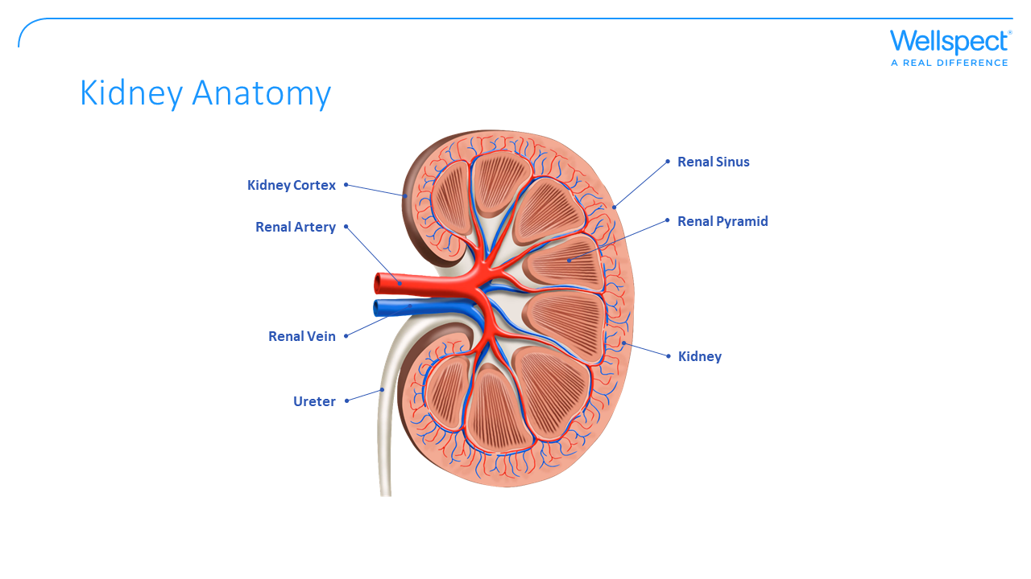
Notes:
Kidneys.
The kidneys main task is to maintain the body’s internal environment (homeostasis). Each kidney contains a million nephrons, where the blood is filtered.
The kidney’s tubules, absorb much of the urine, water, salts and nutritive substances. What remains is a strongly concentrated urine that is collected in the renal pelvis. This includes mostly salts and nitrogen rich waste products. The amount of the urine filtered is thought to be 190 litres per day. The final amount of urine that leaves the body normally lies between one and two litres per day.
In order to cope with its task the kidneys must:
Maintain the body’s water at a constant level
Control the concentration of all salts
Assist with oxygen regulation
Excrete poisons and gather nutritional substances
Produce hormones

Slide 5
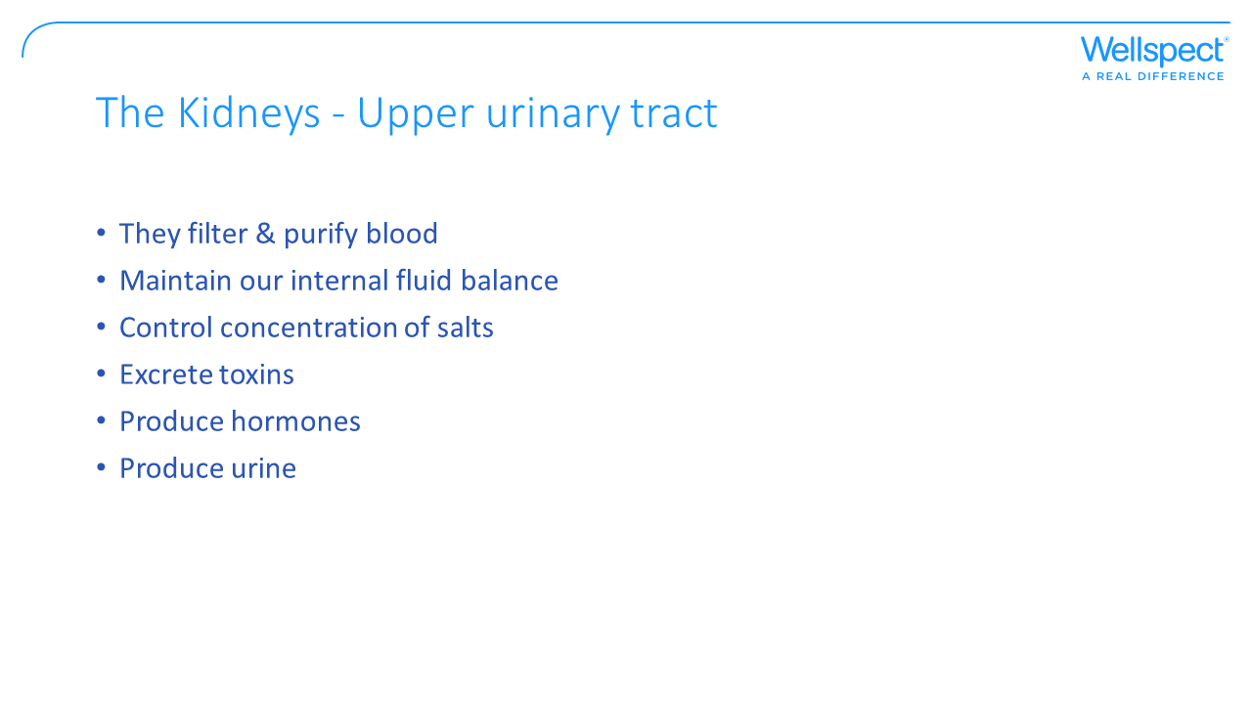

Slide 6
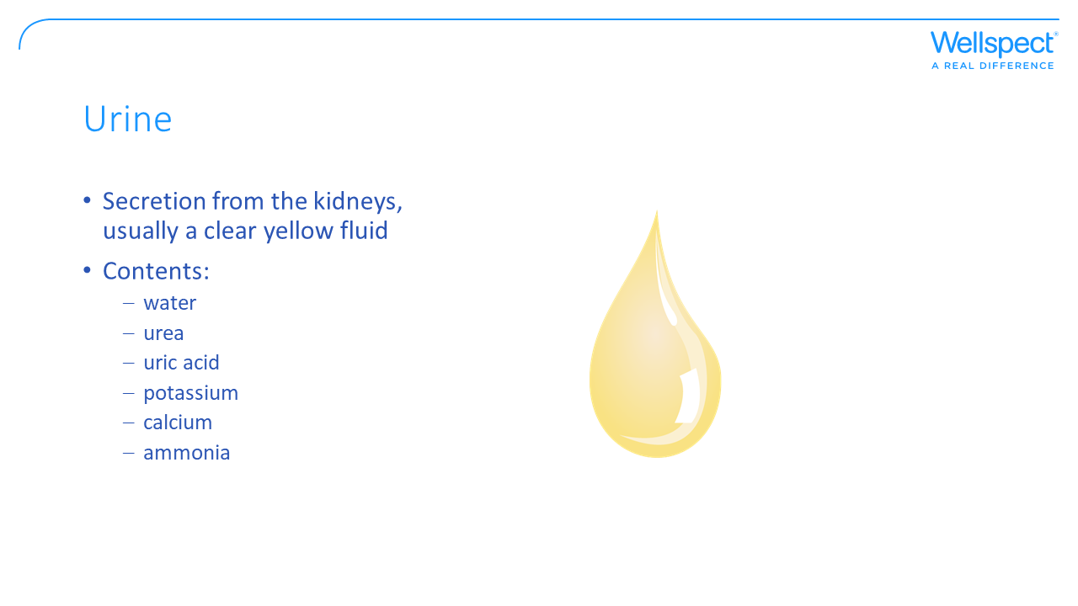
Notes:
The function of urine.
The human body consists of 60% water. Needing to drink an amount of water during the day is completely natural, since we lose water all the time in the form of sweat, breath and urine.
How much liquid we need depends on how much we weigh and how physically active we are. When we pass urine it is partly to get rid of liquid that we don’t need. If we drink a lot, we pass urine a lot. However urine is part of the body’s own purification system.
At least half a litre evaporates in the form of sweat and breath every night when we are asleep. During the day when we work and move, we sweat more and lose more water. Another half litre helps us to clean out poisonous waste products, in the form of urine. The rest is used to fill cells and lubricate moving parts. The skin alone, which is the largest organ, must contain ten percent water in order to maintain its flexibility and pliability.

Slide 7
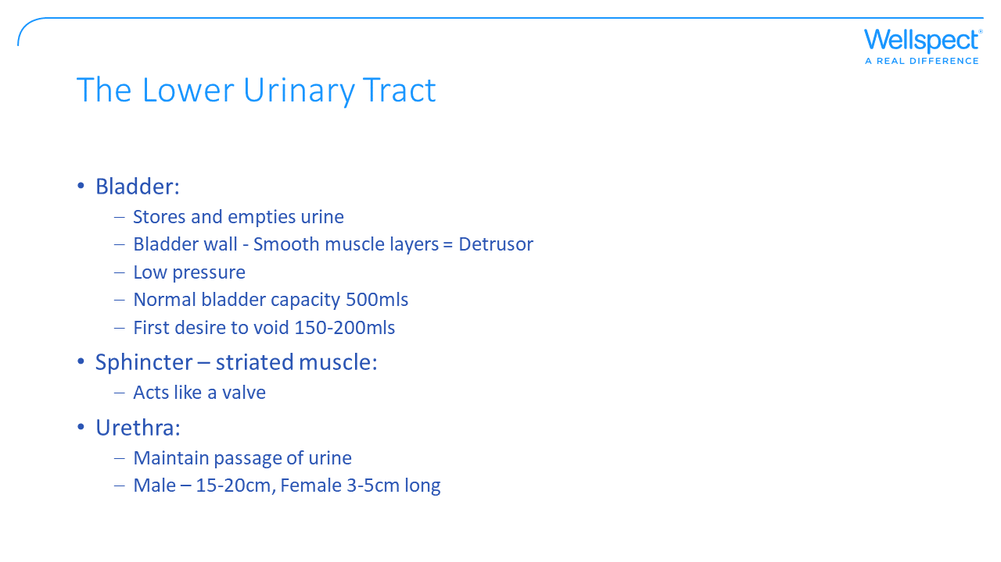

Slide 8
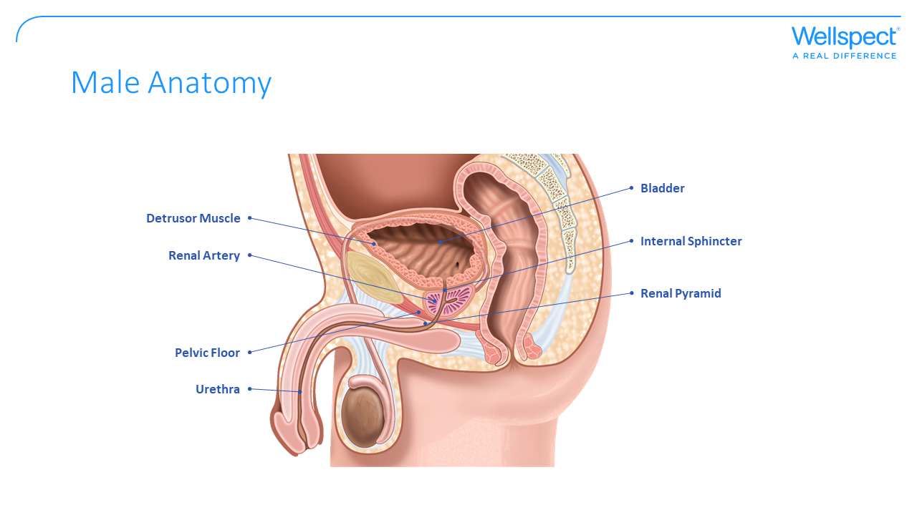
Notes:
The male urethra is in the shape of an S. The length of the urethra is approximately 20–27cm. Males have two sphincters, the internal sphincter, which prevents semen entering the bladder, and the external sphincter, which is made up of striated muscle fibers and can therefore be controlled voluntarily to prevent voiding. The prostate gland lies inferior to the bladder neck. (In order to facilitate insertion of the catheter, the penis is therefore stretched and held in the direction of the abdomen during catheterisation.) Narrow passages are located in the areas of the external sphincter, the prostate, and at the vesical (bladder) neck (internal sphincter).

Slide 9
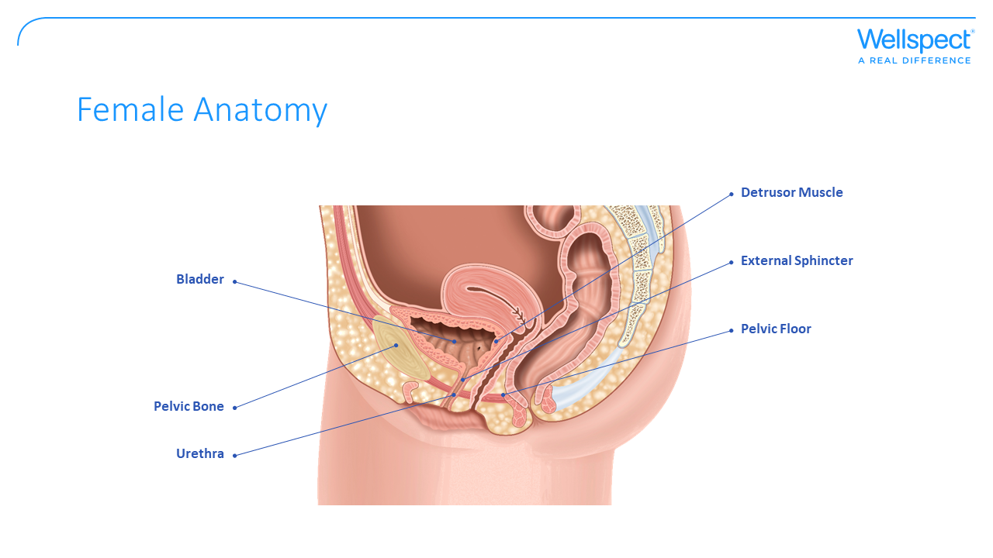
Notes:
The female urethra is a fibromuscular tube, only 3-5 cm long. The entrance to the urethra is located above the vagina. The middle part of the urethra is encircled by striated muscle, whose tone is a factor in maintaining continence of urine. Narrow sections are located in the area of the external bladder sphincter and the vesical (bladder) neck. Owing to the proximity of the anal area to the urethra in the female, compared with the male, there is an increased danger of urinary tract infections due to E. coli bacteria. Anatomical changes in the uterus (e.g. prolapse), may cause bladder function to deteriorate.

Slide 10
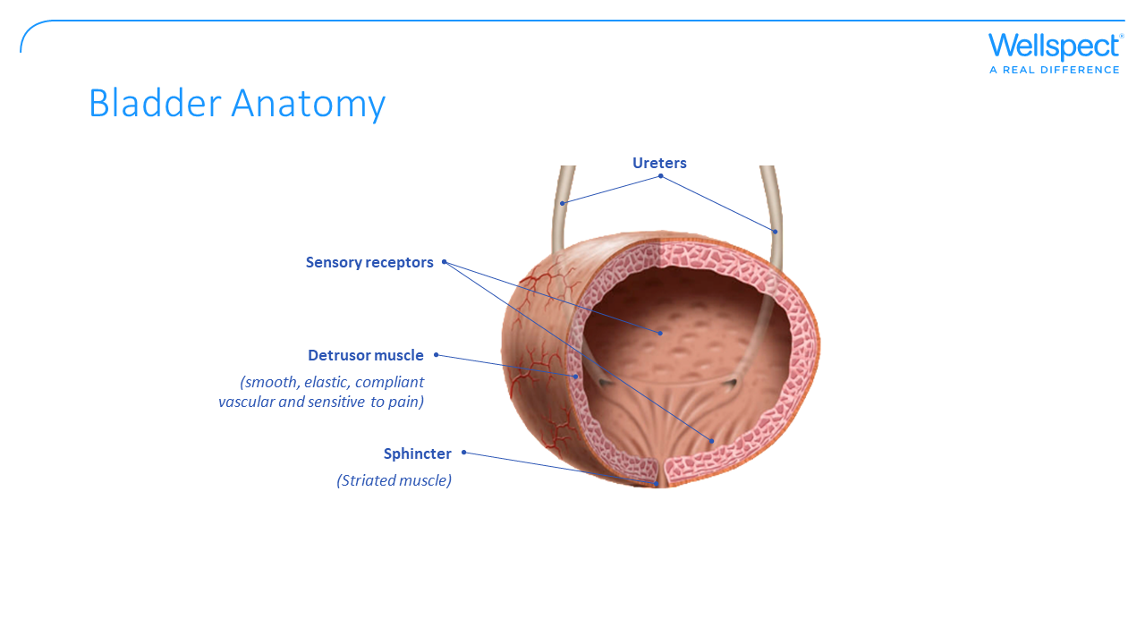
Notes:
Ureters.
Under normal conditions, the body produces approx 1.5 litres of urine per day. The ureters transport the urine from the renal pelvis to the bladder by powerful peristaltic wave movements.
Since the urethra goes obliquely through the bladder wall, the urine is prevented from flowing back towards the kidneys. The transition between the bladder and the urethra works as a valve and prevents the urine from being pushed back towards the kidneys.
If one has kidney stones that hinder or stop the flow in the ureter, it can cause violent cramp-like pain.
Bladder.
(Picture and caption: the lower urinary tracts comprise a bladder (detrusor muscle), urethra and sphincter.
The bladder’s function is to store and empty urine. Internally the bladder is coated by a mucous membrane (called epithelium) that has the ability to be continuously renewed. The main task of the epithelium is to protect the body against urine. The epithelium is helped by, amongst other things, antibodies that protect the body from infections.
The bladder’s walls are made of several muscle layers of smooth muscle. The muscle layers have large amounts of crossing fibres between them. This makes the detrusor capable of considerable stretching without the tension in the walls increasing too much. The result is that the fill pressure (urines pressure in the bladder) can be low.
A collar of smooth muscle runs along the rear and middle of the urethra for men and along the whole of the female urethra. The middle section. The sphincter muscle closes the urethra during the storing phase and open when it receives a signal from the brain.
In the bladder’s wall there are receptors that sense the pressure in the bladder and how much it is stretched. The bladder pressure does not increase during the storing phase.

Slide 11
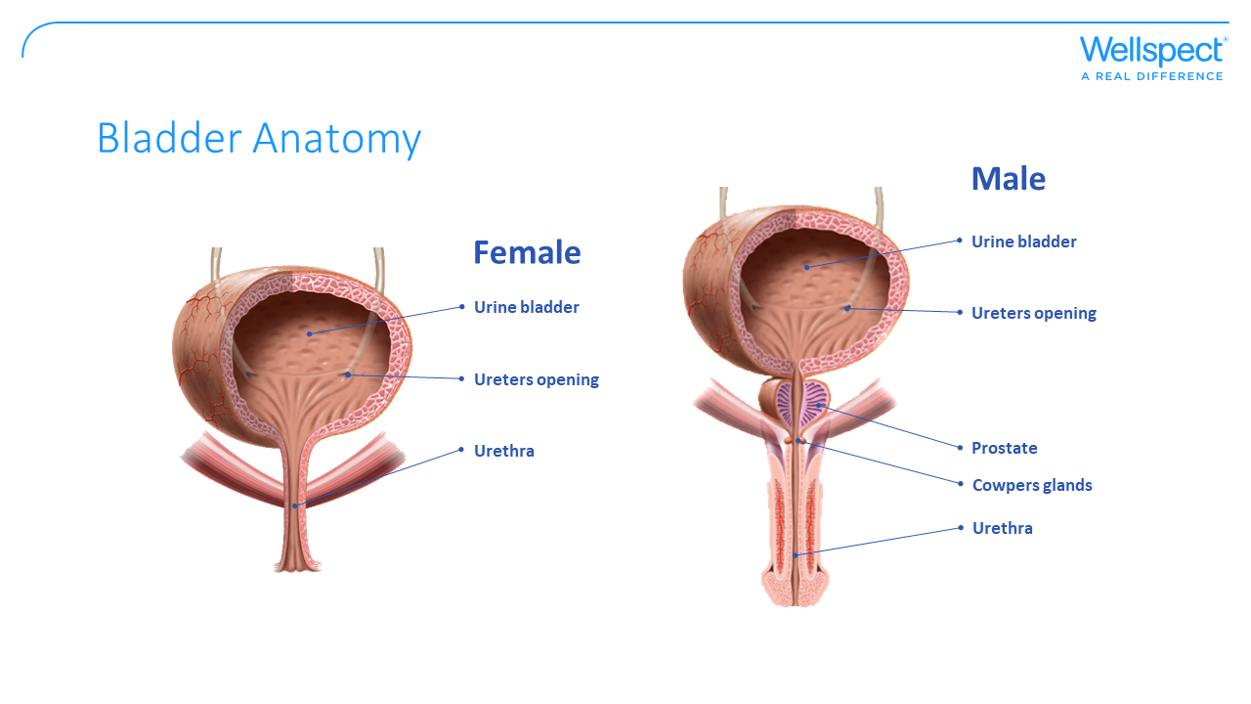
Notes:
Urethra.
The woman’s urethra is approx 3-5 cm long, whilst the man’s is approx 15-20 cm. The urethra’s end muscle has two functions: 1) to keep the urine in the bladder during the storing phase and 2) open when the bladder is to be emptied. Both functions require interplay between the bladder and the urethra.
In the urethra the pressure is higher than in the bladder, which helps to keep the bladder under control.

Slide 12


Slide 13
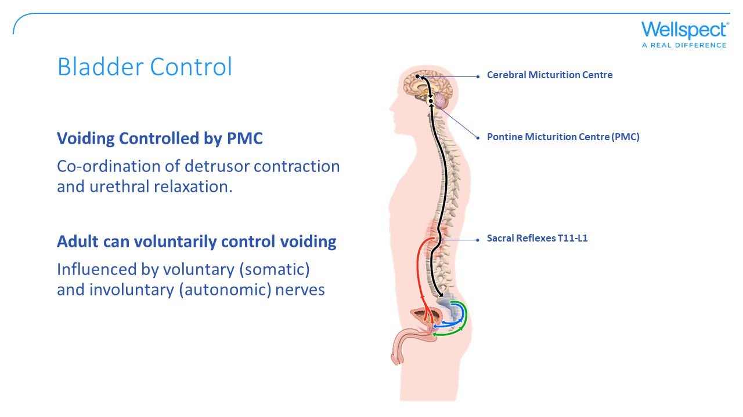
Notes:
How does our nervous system control our bladder function?
For the urinary system to do its job, muscles & nerves must work together to hold urine in the bladder and then release it at the right time
Nerves carry messages from the bladder to the brain to let it know when it is full. They also carry messages from the brain to the bladder, telling muscles either to tighten or release.
So what are the different parts of the nervous system that influence and control the bladder?
They are:
Cerebral control - which is The cortical/cerebral micturition centre and the Pontine micturition centre (PMC) – Located in the brain stem (Pons) at the junction between the brain, spinal cord & autonomic nervous system.
The brain senses when the bladder is full and influences voluntary controls over the bladder. It will also coordinate detrusor contraction & sphincter relaxation (=synergy)
Sacral control - This sacral centre is responsible for reflex control of bladder function. A reflex does not need conscious control to take effect , but involvement of conscious control and the voluntary nerves, can delay or block action. It is located at T11/L1 level which is a common site of traumatic injury.

Slide 14
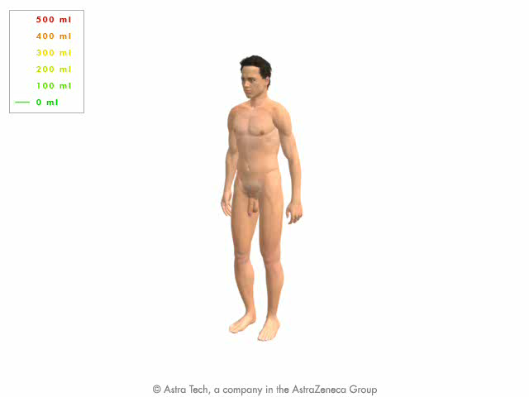
Micturition cycle
Afferent nerves
Efferent sympathetic
Hypogastric nerve
(inhibits)
Efferent parasympathetic
Pelvic nerve
Efferent somatic
Pudendal nerve
Notes:
What happens when one passes urine?
Bladder emptying is also called micturition and is controlled by the central nervous system. What happens is a complex interplay between the voluntary (somatic) and involuntary (autonomic) nervous system. In the autonomic nervous system one differentiates between the parasympathetic and the sympathetic system. The bladder’s storing phase is mostly controlled by the sympathetic system (keeps the urethra closed), whilst the parasympathetic nervous system controls the emptying phase (makes the urethra open).
When we decide to pass urine, the pressure in the urethra reduces, the urethra opens and the bladder contracts until it is empty. Then the bladder goes back to the storing phase, and the pressure in the urethra returns to being higher than the pressure in the bladder.
1) The bladder fills. The detrusor muscle relaxes, the pelvic musculature and passing urine/voiding.
2) sphincter muscles contract (controlled by the sympathetic nervous system).
3) The bladder is half full. One begins to feel tightening and waits for a suitable occasion to pass urine.
The bladder is emptied. The emptying is started by a strain that temporarily increases the pressure on the bladder wall. The detrusor muscles contract, the pelvic musculature and sphincter muscles relax. (Controlled by the parasympathetic nervous system)
The micturition cycle is a circulation that continues all day. Disturbances can occur in all three phases. In order for the bladder function to work properly it is important that the voluntary and involuntary nerve impulses co-operate.

Slide 15
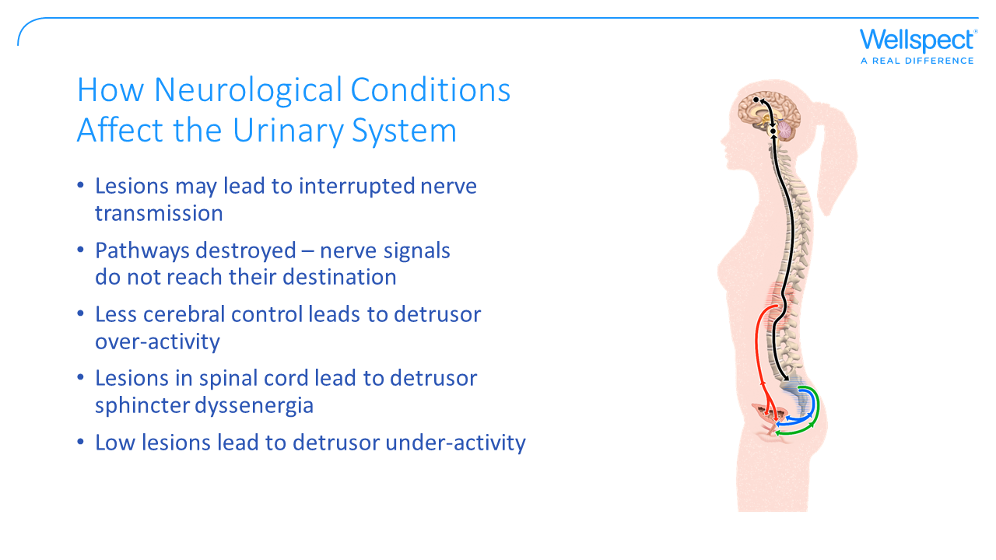
Notes:
How can Neurological damage affect the urinary system?
The spinal cord plays a central role in bladder dysfunction
Read through points on slide, where different areas of damage can lead to different kinds of symptoms

Slide 16
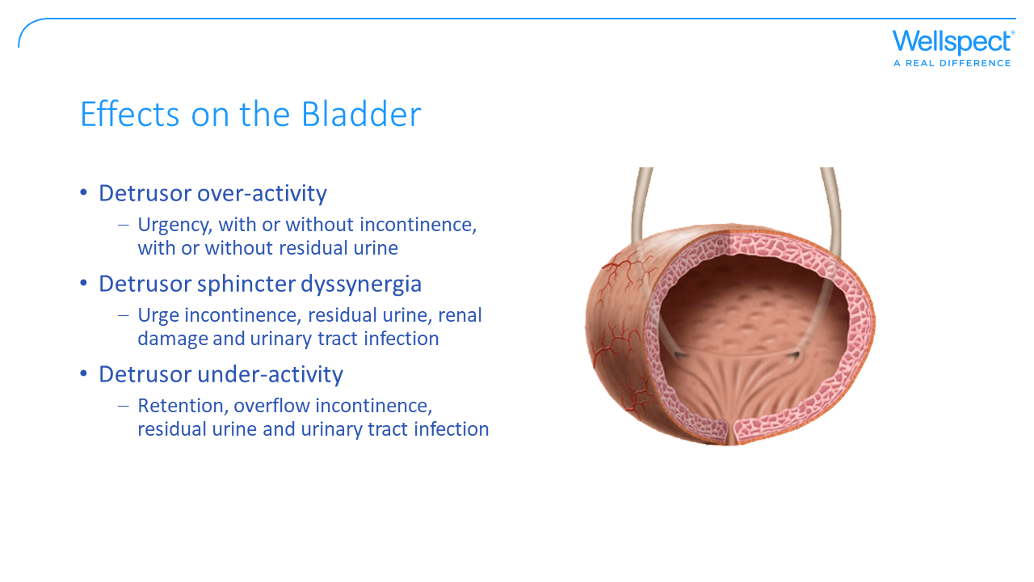

Slide 17


